Slide 1
INVENTORY OPTIMIZATION FOR A WHOLESALE DISTRIBUTOR

Slide 2
CONTENTS
ABSTRACT
INTRODUCTION
LITERATURE REVIEW
EXISTING SYSTEM
PROPOSED SYSTEM
RESULTS
CONCLUSION
FUTURE SCOPE
REFERNECES

Slide 3
ABSTRACT
In today’s highly dynamic supply chain environment, effective inventory management is critical for minimizing operational costs and improving decision-making efficiency. This project focuses on optimizing inventory levels for a wholesale distributor by integrating data analytics, demand prediction, and visualization techniques. The study begins with systematic data collection and problem understanding, followed by data cleaning and preprocessing to ensure accuracy and consistency. Exploratory Data Analysis (EDA) is performed to identify sales patterns, demand variability, and relationships among product categories. A regression-based demand prediction model is then developed to forecast inventory requirements, enabling proactive stock planning. Based on the predicted demand, optimal inventory levels and reorder insights are derived to reduce overstocking and understocking risks. Finally, an interactive Power BI dashboard is created to visualize stock movement, average demand, and predicted inventory needs, supporting real-time decision-making. The results demonstrate that data-driven inventory optimization can significantly enhance operational efficiency, reduce inventory holding costs, and improve supply chain responsiveness. This approach provides a scalable and practical decision support framework for effective inventory management in wholesale distribution systems, enabling better strategic planning, improved customer satisfaction, and long-term business sustainability.

Slide 4
INTRODUCTION
In today’s rapidly evolving supply chain environment, efficient inventory management has become a critical factor in improving operational performance and sustaining organizational competitiveness. Wholesale distributors often face significant challenges such as overstocking and understocking, which result in increased holding costs, capital blockage, stock-out risks, and diminished customer satisfaction. Conventional inventory management approaches typically depend on static rules, manual monitoring, and historical averages, making them inadequate for responding to fluctuating demand, seasonal variations, and market uncertainties.With the increasing availability of large volumes of transactional data, modern supply chains demand analytical, automated, and technology-driven solutions to improve accuracy and agility. Data-driven inventory optimization enables organizations to gain real-time visibility into stock levels, anticipate demand changes, and make proactive decisions. Advanced analytics and visualization tools play a vital role in transforming raw data into actionable insights, supporting better planning and control across the supply chain.

Slide 5
This project, Inventory Optimization for a Wholesale Distributor, aims to address inventory inefficiencies by leveraging data analytics and business intelligence techniques. Sales and inventory data are processed and analyzed using Python libraries such as NumPy and Pandas to identify demand patterns, trends, and anomalies. Exploratory Data Analysis (EDA) is conducted to evaluate product performance, sales behavior, and inventory movement. Regression-based demand forecasting models are then applied to predict future inventory requirements and optimize reorder levels. Additionally, interactive Power BI dashboards are developed to visually represent key inventory metrics, including stock movement, demand fluctuations, reorder points, and inventory turnover. These dashboards provide decision-makers with clear, real-time insights, enabling effective monitoring and strategic planning. The proposed solution helps minimize excess inventory, prevent stock-outs, reduce operational costs, and enhance overall supply chain efficiency, thereby supporting informed, proactive, and sustainable inventory management practices that improve profitability, scalability, responsiveness, and long-term operational resilience across wholesale distribution networks.

Slide 6
LITERATURE REVIEW
TITLE & AUTHORS | METHODOLOGY (DATA FORMAT) | PROPOSED SYSTEM | CON’s | CONCLUSION
1. Supply Chain Resilience: A Review from the Inventory Management Perspective Guo, Y.; Liu, F.; Song, J.-S.; Wang, S. (2025) | Systematic literature review Secondary data from journals, conceptual and analytical models | Inventory-based resilience framework focusing on safety stock, multi-sourcing, and risk pooling | Lacks empirical validation; implementation challenges in real-time systems) | Inventory management plays a critical role in enhancing supply chain resilience against disruptions

Slide 7
TITLE & AUTHORS | METHODOLOGY (DATA FORMAT) | PROPOSED SYSTEM | CON’s | CONCLUSION
2. Optimising Inventory Management Strategies for Cost Reduction in Supply Chains: A Systematic Review Olaniyi, O.A.; Pugal, P.S. (2024). | Systematic review Qualitative secondary data from peer-reviewed articles | Cost-optimized inventory strategies using EOQ, JIT, ABC analysis, and demand forecasting | Does not consider industry-specific constraints; limited focus on sustainability | Optimized inventory strategies significantly reduce operational costs and improve efficiency

Slide 8
TITLE & AUTHORS | METHODOLOGY (DATA FORMAT) | PROPOSED SYSTEM | CON’s | CONCLUSION
3. Optimizing Supply Chain and Logistics Management: A Review of Modern Practices Anaba, D.; Kess-Momoh, A.; Ayodeji, S. (2023) | Regression‑based demand forecasting using historical sales data | Use of regression models to predict product demand and support inventory planning | Forecast accuracy depends on data quality; assumes linear relationships | Regression models improve forecasting accuracy and reduce overstocking and stock‑out risks

Slide 9
TITLE & AUTHORS | METHODOLOGY (DATA FORMAT) | PROPOSED SYSTEM | CON’s | CONCLUSION
4. Carbon Emissions Effect on Vendor-Managed Inventory System Considering Displaced Re-Start-Up Production Time Alamri, A.A. (2022) | Data preprocessing, exploratory data analysis, predictive modeling | Integration of data analytics tools for inventory decision support | Requires technical expertise and analytical tools | Data‑driven approaches enhance inventory visibility and operational efficiency

Slide 10
TITLE & AUTHORS | METHODOLOGY (DATA FORMAT) | PROPOSED SYSTEM | CON’s | CONCLUSION
5. Efficiency of Inventory in Thai Hospitals: Comparing Traditional and Vendor-Managed Inventory Systems Adirektawon, S.; Theeraroungchaisri, A.; Sakulbumrungsil, R.C. (2021) | Dashboard creation using BI tools such as Power BI | Real‑time visualization of inventory levels, demand trends, and reorder points | Dependent on data integration quality | BI dashboards improve managerial decision‑making and supply chain responsiveness

Slide 11
EXISTING SYSTEMS
In the existing inventory management system of wholesale distributors, inventory decisions are primarily made through manual methods and human judgment. Stock levels are maintained based on past experience rather than accurate data analysis. This approach often results in overstocking, which increases storage, warehousing, and holding costs. Excess inventory also leads to product damage, obsolescence, and inefficient use of storage space, ultimately increasing operational expenses. At the same time, the absence of demand forecasting techniques causes frequent understocking situations. Stockouts lead to missed sales opportunities, delayed order fulfillment, and reduced customer satisfaction. The existing system lacks proper visualization tools to monitor inventory movement and sales trends, making it difficult for decision-makers to identify demand patterns. Due to the high dependency on experience rather than data-driven insights, the system fails to respond effectively to changing market demands and seasonal variations. In the existing system, there is no effective mechanism to define optimal reorder levels or maintain appropriate safety stock, leading to inefficient inventory control.

Slide 12
Reordering decisions are typically based on fixed time intervals, managerial intuition, or urgent stock requirements rather than actual demand patterns, which often results in emergency purchases or excessive bulk ordering. These reactive practices increase procurement and transportation costs, cause storage constraints, and negatively impact cash flow. Moreover, frequent last-minute orders strain supplier relationships, reduce negotiation leverage, and may lead to inconsistent lead times. The lack of standardized inventory policies and performance metrics makes it difficult to ensure consistent service levels, resulting in delayed order fulfillment and customer dissatisfaction. Additionally, inventory records are often maintained manually or in isolated systems, increasing the risk of data inaccuracies, duplication, and miscommunication across departments. As the number of products, suppliers, and customers grows, the traditional system becomes increasingly difficult to manage, error-prone, and time-consuming. Without analytical tools or data-driven insights, wholesale distributors are unable to accurately forecast demand, respond to seasonal fluctuations, or adapt to changing market conditions. Consequently, the system lacks scalability, flexibility, and long-term reliability, limiting operational efficiency and hindering sustainable business growth.

Slide 13
PROPOSED SYSTEMS
The proposed system introduces a comprehensive, data-driven approach to inventory optimization by effectively utilizing historical sales and inventory data to support accurate and timely decision-making. Initially, raw data collected from sales and inventory databases is cleaned, validated, and preprocessed using Python libraries such as NumPy and Pandas. This step involves removing duplicate records, handling missing or inconsistent values, and standardizing data formats to ensure reliability and analytical accuracy. Once the data is prepared, trend analysis is performed to identify demand patterns, seasonal fluctuations, and long-term sales behaviors across different products. By examining these trends, the system distinguishes between fast-moving, slow-moving, and non-moving items, allowing organizations to understand product performance in greater detail. This structured analysis provides valuable insights into customer demand and inventory turnover, enabling more effective inventory planning and reducing dependence on manual judgment or intuition-based decisions. As a result, inventory policies become more systematic, consistent, and aligned with actual business requirements.

Slide 14
To further enhance inventory management capabilities, regression-based predictive models are applied to forecast future demand and estimate inventory requirements. These models analyze historical sales trends and relationships between variables to predict future consumption patterns with greater accuracy. Based on these predictions, the system calculates optimal reorder levels and safety stock thresholds, helping to minimize the risks associated with overstocking and stock-outs. This predictive approach ensures that inventory levels are balanced to meet customer demand while controlling holding and procurement costs. The outcomes of the analysis, including predicted inventory levels, stock movement trends, and reorder recommendations, are visualized through interactive Power BI dashboards. These dashboards present key performance indicators such as demand trends, current stock status, inventory turnover, and reorder alerts in a clear and user-friendly format. Real-time visualization enables managers to monitor inventory performance efficiently, identify potential issues early, and make informed decisions promptly. Overall, the proposed system enhances operational efficiency, improves inventory accuracy, reduces costs, and supports proactive, data-driven inventory planning for wholesale distributors in a dynamic and competitive market environment.

Slide 15
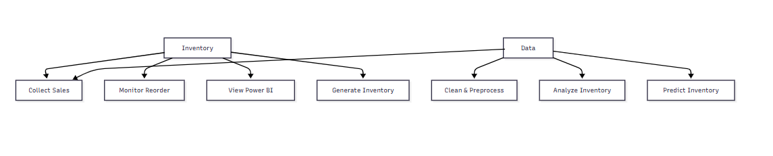
OVERALL SYSTEM FUNCTIONALITY
UML DIAGRAMS
The Use Case Diagram represents the interaction between users and the Inventory Optimization system. It involves two main actors: the Inventory Manager and the Data Analyst. The Data Analyst performs tasks such as collecting sales data, cleaning and preprocessing data, analyzing inventory trends, and predicting inventory demand. The Inventory Manager monitors reorder levels, views Power BI dashboards, and generates inventory reports. This diagram provides a clear overview of the system’s overall functionality and user responsibilities..

Slide 16
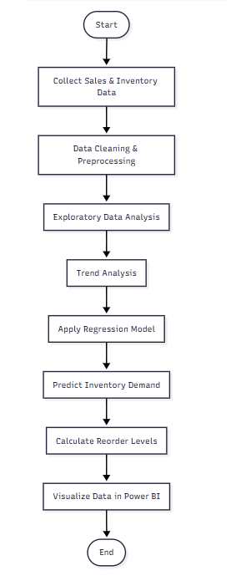
PROCESS FLOW OF INVENTORY OPTIMIZATION
The activity diagram illustrates the complete workflow of the inventory optimization process in a systematic manner. It starts with the collection of sales and inventory data from reliable sources, which is then cleaned and preprocessed to remove errors and inconsistencies. Exploratory data analysis and trend analysis are performed to identify demand patterns and seasonal variations. Based on these insights, regression models are applied to accurately predict future inventory demand and determine optimal reorder levels. Finally, the outcomes are visualized through interactive Power BI dashboards, enabling inventory managers to monitor stock movement.

Slide 17
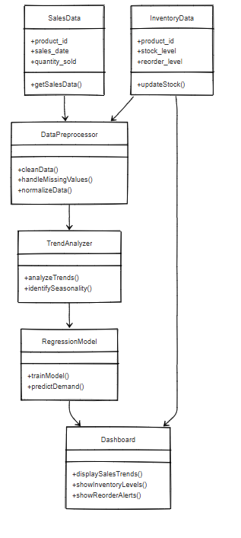
SYSTEM STRUCTURE
The class diagram represents the structural architecture of the inventory optimization system and defines the relationships between its core components. It illustrates how Sales Data and Inventory Data act as primary inputs to the system and are processed by the Data Preprocessor, which handles data cleaning, normalization, and missing values. The Trend Analyzer examines historical patterns, seasonality, and demand behavior to generate meaningful insights. These insights are then passed to the Regression Model, which predicts future inventory requirements and optimal stock levels. Finally, the Dashboard class presents sales trends, inventory status, and reorder alerts through visual reports, enabling accurate, efficient, and data-driven inventory decision-making.

Slide 18
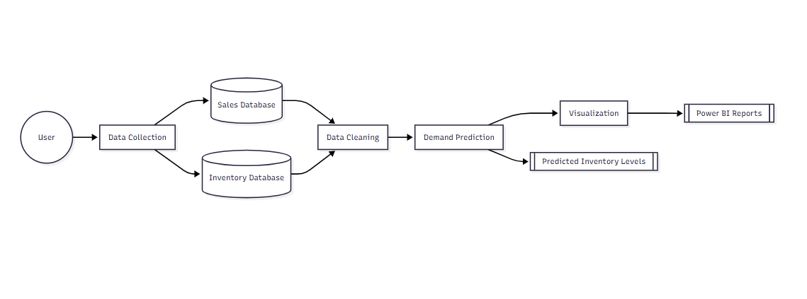
DATA FLOW DIAGRAM
This Data Flow Diagram represents the movement of data within the inventory optimization system in a clear and structured manner. It illustrates how raw sales and inventory data are initially collected from various sources and stored in dedicated sales and inventory databases. The collected data then flows into the data cleaning process, where inconsistencies, missing values, and errors are identified and corrected to ensure data quality and reliability. After cleaning, the processed data is used for demand prediction, where analytical and regression models analyze historical patterns to forecast future inventory requirements. The predicted inventory levels help determine optimal stock and reorder quantities, reducing the risks of overstocking and understocking. Finally, the results are passed to the visualization process

Slide 19
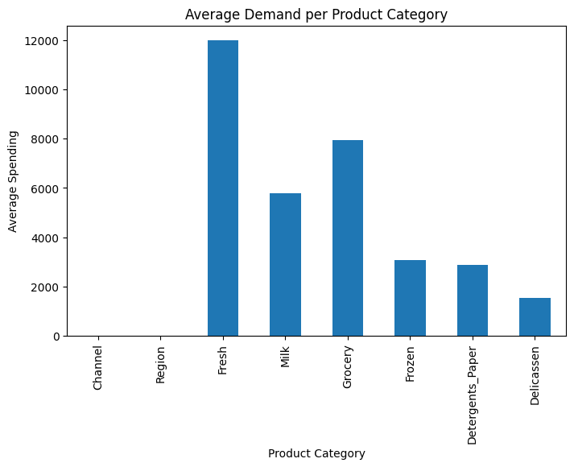
DATA VISUALIZATION BAR CHART – DEMAND COMPARISON
RESULTS
The bar chart illustrates the average demand (average spending) across different product categories handled by the wholesale distributor. From the graph, Fresh products show the highest average demand, indicating that they are the most frequently purchased and require careful inventory planning to avoid stock‑outs. consistent customer consumption and the need for regular replenishment.

Slide 20
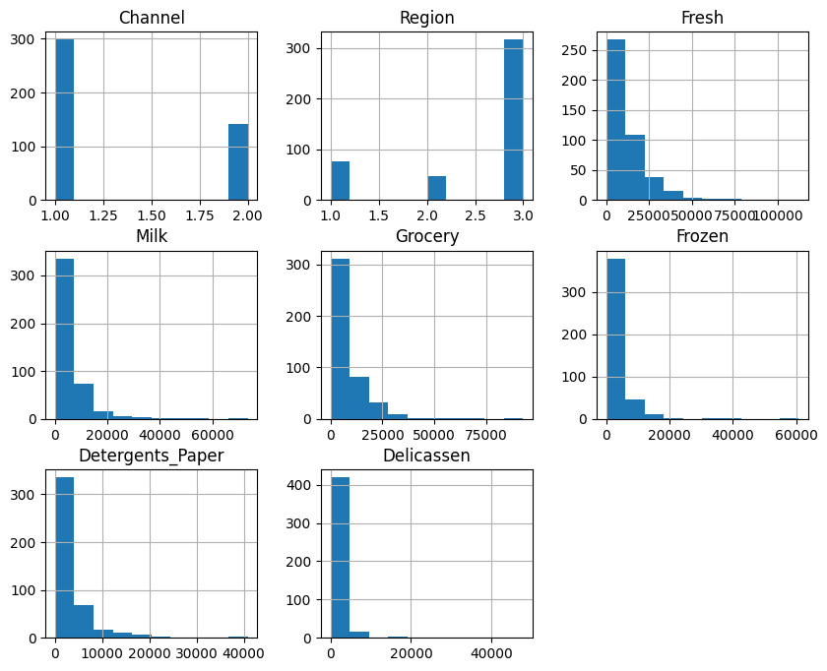
DISTRIBUTION ANALYSIS
It includes categorical attributes such as Channel and Region, showing how data is distributed across different customer segments and geographical areas. The remaining plots represent sales quantities for product categories like Fresh, Milk, Grocery, Frozen, Detergents_Paper, and Delicatessen. Most product categories show a right-skewed distribution, indicating that a large number of customers purchase smaller quantities.

Slide 21
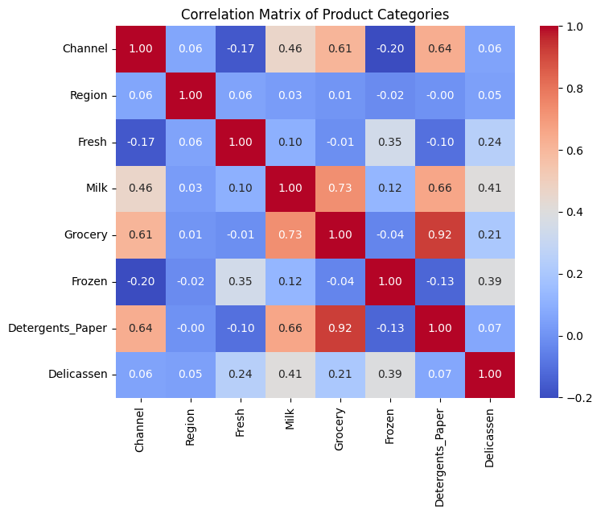
CORRELATION MATRIX OF PRODUCT CATEGORIES
The correlation matrix illustrates the relationships between different product categories and customer attributes. Strong positive correlations are observed between Grocery and Detergents_Paper and between Grocery and Milk, indicating related purchasing behavior. Moderate correlations exist among Milk, Delicatessen, and other categories, while Fresh and Frozen show weaker relationships. Overall, the matrix helps identify product associations useful for inventory planning and demand forecasting.

Slide 22
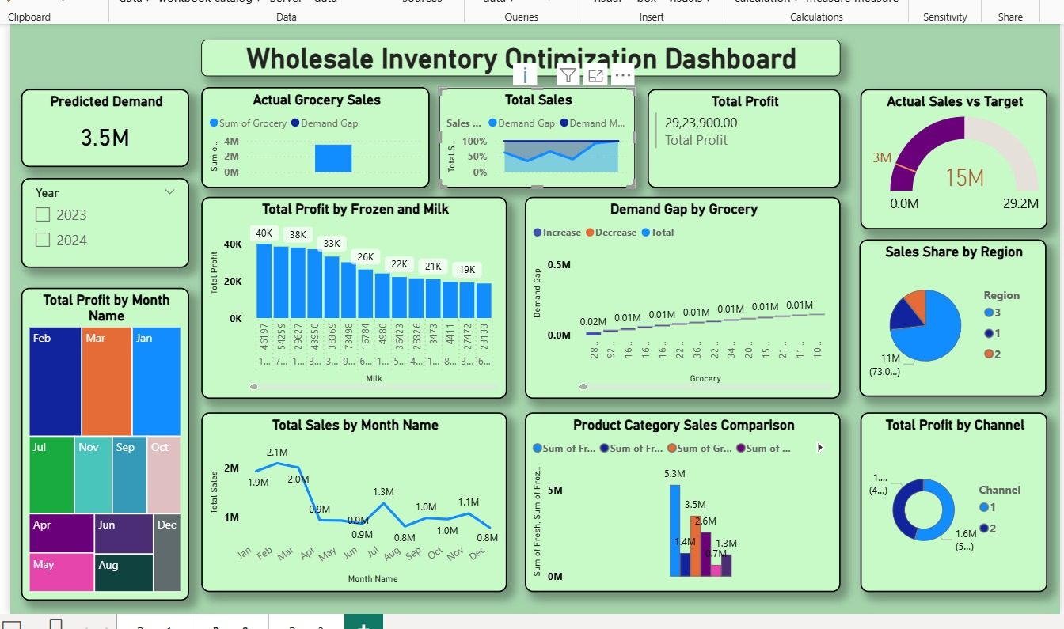
WHOLESALE INVENTORY OPTIMIZATION DASHBOARD-VISUALIZATION
The Wholesale Inventory Optimization Dashboard provides a comprehensive, data-driven view of sales performance, demand trends, and profitability to support effective inventory planning. The dashboard highlights a predicted demand of 3.5 million units, enabling decision-makers to align procurement and stock levels with expected market needs. Actual grocery sales and total sales indicators help compare real performance against forecasts, while the total profit of ₹29,23,900 offers a clear snapshot of financial health.Interactive filters for year (2023–2024) and month allow users to analyze seasonal patterns and monthly sales fluctuations. The total sales by month chart reveals demand variability across the year, helping identify peak and low-sales periods. Product-level insights are provided through profit analysis for frozen and milk categories, showing which items contribute most to overall profitability.

Slide 23
CONCLUSION
This project successfully demonstrates the effective application of data analytics techniques to optimize inventory management for wholesale distributors. By leveraging historical sales and inventory data, the system provides a structured and analytical approach to addressing common inventory challenges such as overstocking and understocking. The use of Python libraries such as NumPy and Pandas enables efficient data cleaning, preprocessing, and exploratory analysis, ensuring that the data used for decision-making is accurate and reliable. Through trend analysis, the system identifies demand patterns, seasonal variations, and product movement behavior, which are essential for effective inventory planning.Regression models are applied to forecast future inventory requirements based on historical demand, allowing wholesalers to maintain optimal stock levels and reduce unnecessary holding costs. The integration of Power BI dashboards plays a crucial role by transforming complex analytical results into clear and interactive visualizations.

Slide 24
FUTURE SCOPE
The proposed inventory optimization system can be further enhanced by integrating real-time inventory and sales data to enable continuous monitoring and instant decision-making. Advanced machine learning models such as ARIMA and LSTM can be implemented to improve demand forecasting accuracy by capturing seasonal patterns and complex trends. The system can also be extended with an automated reorder mechanism that triggers purchase orders when stock levels fall below predefined thresholds. Deploying Power BI dashboards on cloud platforms would allow remote access, scalability, and real-time updates for stakeholders. Additionally, incorporating supplier performance analysis and expanding the system to support multi-warehouse inventory optimization would significantly improve supply chain efficiency and business scalability.

Slide 25
REFERENCES
Guo, Y.; Liu, F.; Song, J.-S.; Wang, S.
Supply Chain Resilience: A Review from the Inventory Management Perspective.
Fundamental Research, 2025, 5, 450–463.
Olaniyi, O.A.; Pugal, P.S. Optimising Inventory Management Strategies for Cost Reduction in Supply Chains: A Systematic Review. Jurnal Akuntansi dan Bisnis, 2024, 10, 48–55.
Anaba, D.; Kess-Momoh, A.; Ayodeji, S.
Optimizing Supply Chain and Logistics Management: A Review of Modern Practices.
Open Access Research Journal of Science and Technology, 2023, 11, 020–028.
Alamri, A.A.
Carbon Emissions Effect on Vendor-Managed Inventory System Considering Displaced Re-Start-Up Production Time.
Logistics, 2022, 7, 67.
Adirektawon, S.; Theeraroungchaisri, A.; Sakulbumrungsil, R.C.
Efficiency of Inventory in Thai Hospitals: Comparing Traditional and Vendor-Managed Inventory Systems.
Logistics, 2021, 8, 89.

